Slide 1

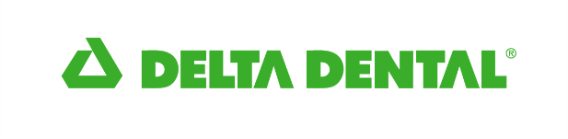

Our mission
Promote healthier lives.
Our vision
Be a leader in customer-centric products and innovations for oral and overall health as well as a beacon of societal equity.

Slide 2



Why do more than 4.4 million people trust Delta Dental of Minnesota with their smiles?
Nationwide networks providing excellent access to members
Extensive savings to employers and members
At Delta Dental, our #1 priority is oral health.
Reflects 2023 data
Notes:
SOURCE: 2023 internal report, Qvidian

Slide 3
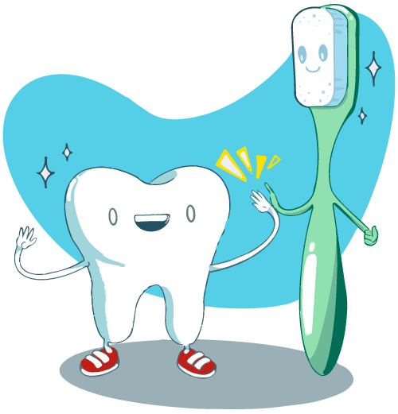
Reasons to visit the dentist
The standard recommendation is to see your dentist at least once per year. This sounds small, but when it comes to your health, the impacts are BIG!
A single appointment with your dentist can:
Improve the health of your teeth & gums with a
thorough cleaning.
Reveal oral health issues such as cavities & gum disease.
Provide an opportunity to screen for more serious underlying health conditions.
Receive personal oral health advice and care so you have the best information to keep your mouth healthy.

Slide 4
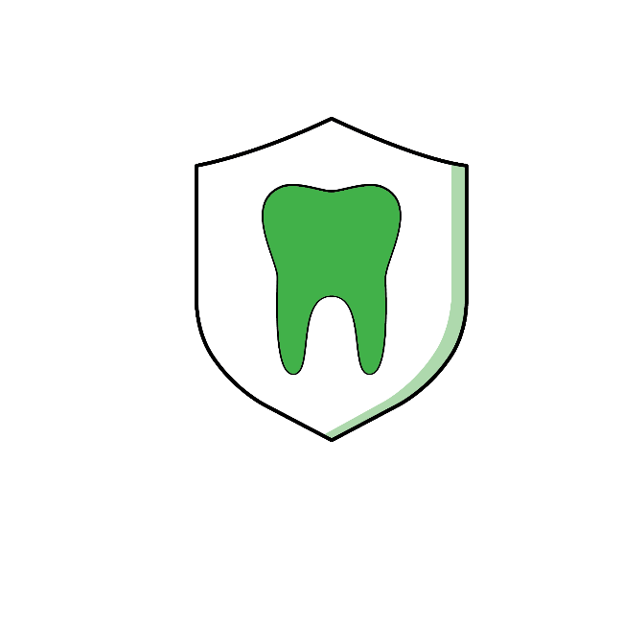
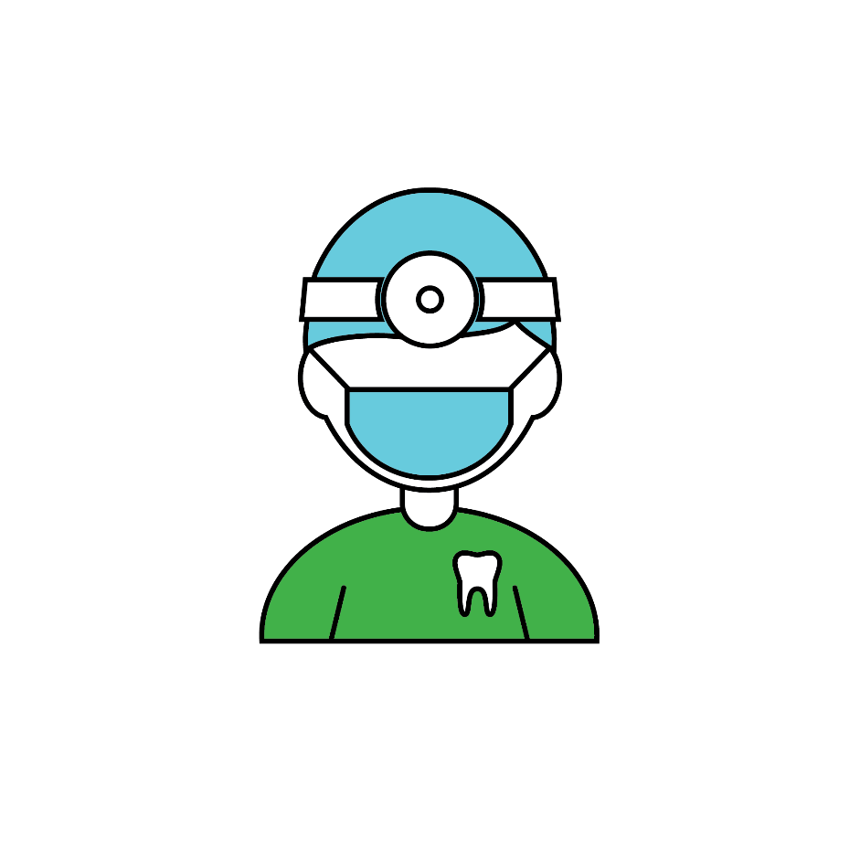

In-network coverage
Perks of seeing an in-network dentist include:
(Delta Dental PPO™/Delta Dental Premier®)
Network savings on covered services
No balance billing
Annual benefit dollars go further
Dentists submit claims directly to Delta Dental
Delta Dental sends plan payment directly
to dentist
Learn More
Notes:
Note: Youtube link references MN network, national clients may want to leave out.

Slide 5

Out-of-network coverage
What happens when you visit an
out-of-network dentist?
If the dentist’s fees are higher than Delta Dental’s allowable charge, you may be responsible to pay the difference.
You are responsible for submitting a claim form to Delta Dental, though your dentist may assist you.
Benefit payments go directly to you.
Notes:
Note: Remove last bullet for ND Clients.

Slide 6
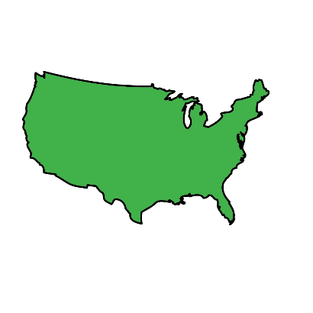
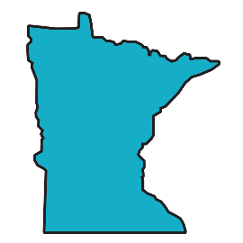
Network size
Delta Dental Premier®
152,187 Dentists
Delta Dental PPOTM
National
114,530 Dentists
Delta Dental Premier®
2,827 Dentists
Delta Dental PPOTM
Minnesota
1,820 Dentists
Reflects June 2024 data
Notes:
TALKING POINTS: Based off Dec 2023 Network Penetration
76 percent of providers nationally participate in the Delta Dental Premier® network
57 percent of providers nationally participate in the Delta Dental PPO network
Current member network access in Minnesota Dec 2023 Penetration report
85 percent of providers are Delta Dental Premier®
55 percent of providers are Delta Dental PPO™
Current member network utilization
77 percent of providers nationally participate in the Delta Dental Premier® network
57 percent of providers nationally participate in the Delta Dental PPO™ network
Current member network utilization for Minnesota
86 percent of providers are Delta Dental Premier®
55 percent of providers are Delta Dental PPO™

Slide 7


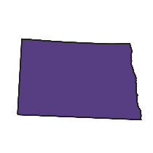
Network size
Delta Dental Premier®
152,187 Dentists
Delta Dental PPOTM
National
114,530 Dentists
Delta Dental Premier®
2,827 Dentists
Delta Dental PPOTM
1,820 Dentists
Minnesota
Delta Dental Premier®
243 Dentists
Delta Dental PPOTM
North Dakota
84 Dentists
Reflects June 2024 data
Notes:
TALKING POINTS: Based off Dec 2023 Network Penetration
75 percent of providers nationally participate in the Delta Dental Premier® network
57 percent of providers nationally participate in the Delta Dental PPO network
Current member network access in Minnesota Dec 2023 Penetration report
85 percent of providers are Delta Dental Premier®
55 percent of providers are Delta Dental PPO™
Current member network access in North Dakota Dec 2023 Penetration report
60 percent of providers are Delta Dental Premier®
22 percent of providers are Delta Dental PPO™

Slide 8

Digital member tools

Slide 9
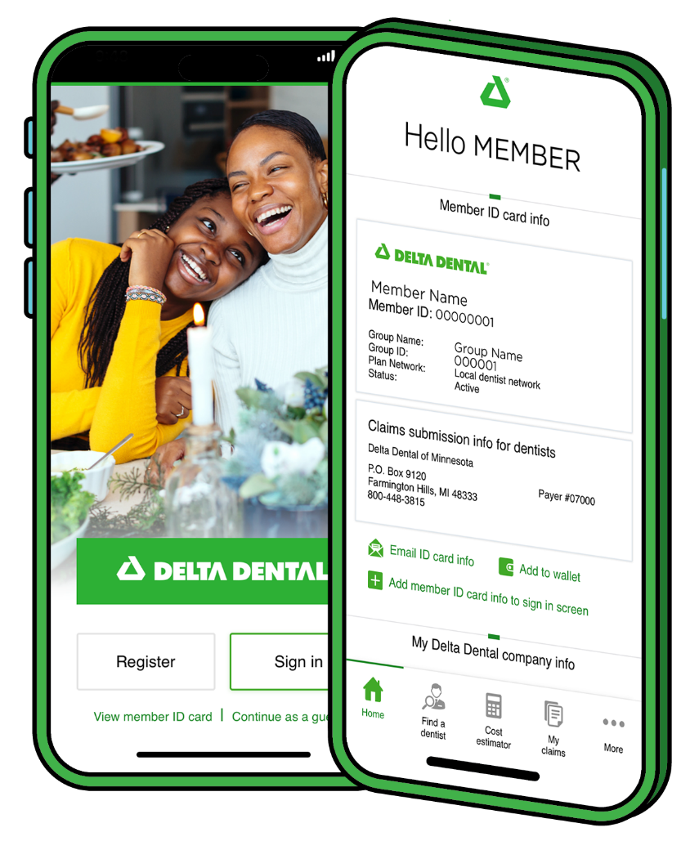
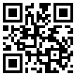

Mobile app
With the Delta Dental mobile app, you can reduce your carbon footprint and access your insurance benefits and ID card from anywhere.
Features:
One-touch mobile ID card
Cost estimator
Find a Dentist tool
Claims details
Learn More
Notes:
Talking point: You can add to wallet in your iPhone

Slide 10
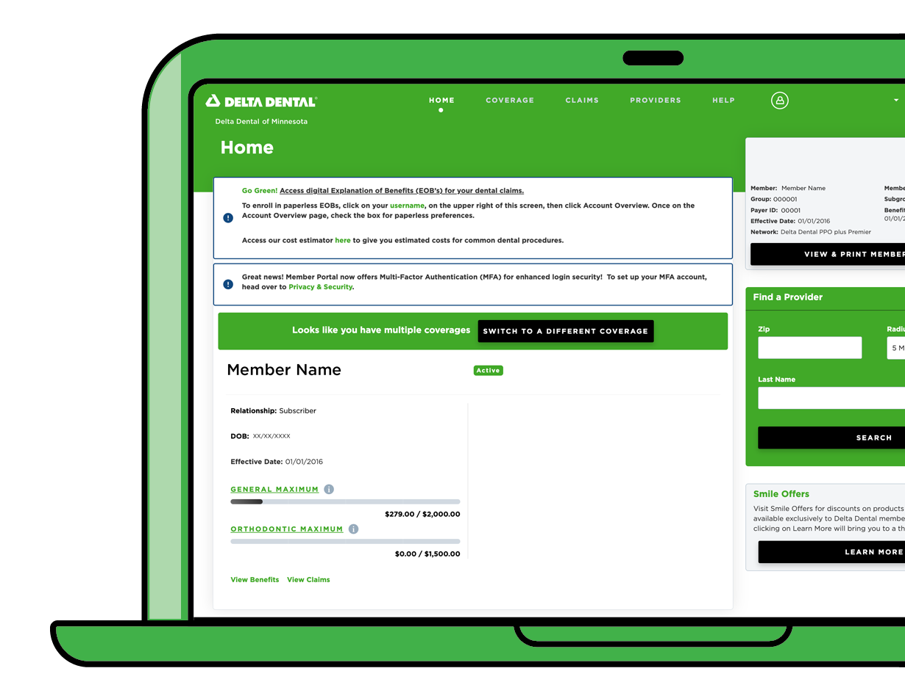
Member Portal
DeltaDentalMN.org/members
Features:
View claims history
View coverage/benefits
View and print ID cards
Update email address
Find a Dentist tool
Learn More

Slide 11
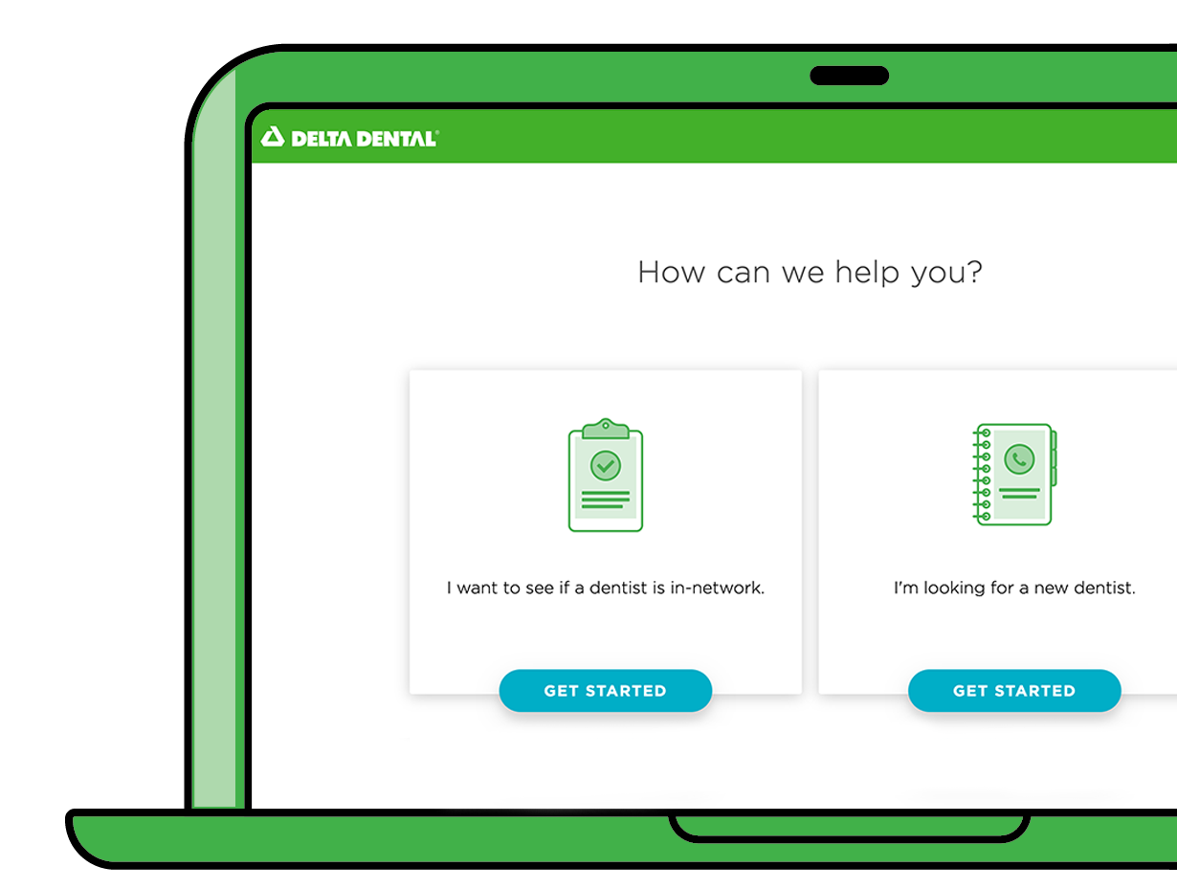
Find a Dentist tool
DeltaDentalMN.org/find-a-dentist
Users have the option to search for a new dentist or see if current dentist is in network.
Search by: location, name and network.
In-depth results show providers and clinics, proximity of public transit, accessibility and more.

Slide 12
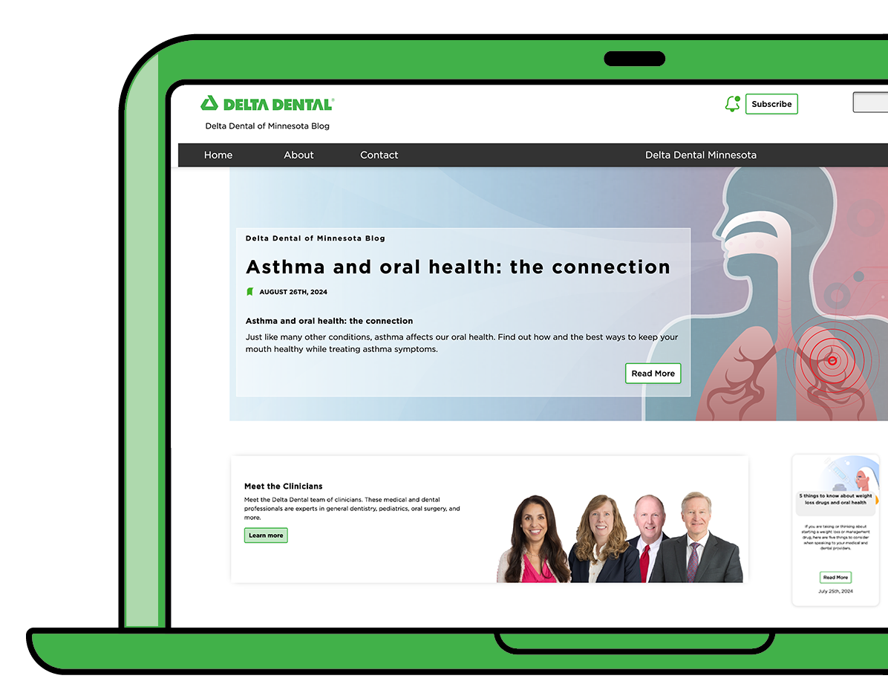
The Power of SmileTM Blog
blog.DeltaDentalMN.org
Learn about current topics and trends in dentistry and the importance of oral health as it relates to overall health from our team of experts.
Notes:
Features:
Extensive library of topics
Easy subscription sign up
Quick filters and search capabilities
Written by our in-house clinicians
Since we fully launched this in 2022 we have seen a huge increase in subscriptions. It’s important to note that this is all organic growth – there is no advertising dollars to support this blog – it is all through word of mouth. I am happy to report that since the launch we’ve had less than 3% of our subscribers opt out which means the information we are sending them is valuable and helps further position us as an oral health leader.

Slide 13
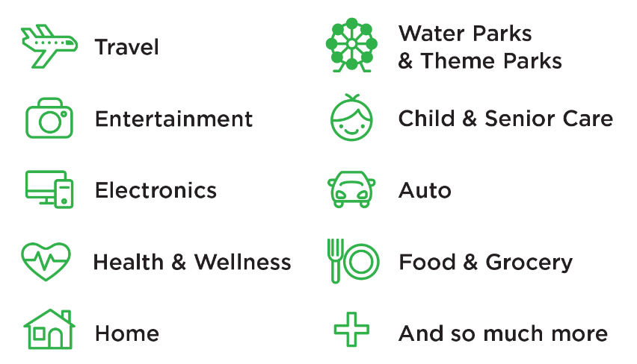
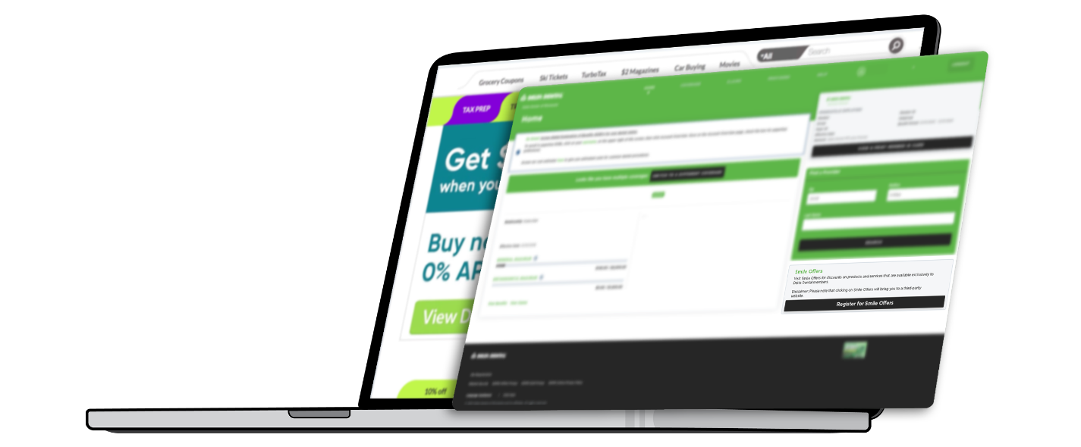
Smile Offers!
Exclusive discounts on products and services available to Delta Dental of Minnesota members.
Access your Smile Offers:
Log onto the Member Portal and click Smile Offers.
You will automatically be redirected
to a third-party exclusive discount site where you can sign up for special offers.
Start saving!
Notes:
Optional Slide: New Value-added Benefit 2024

Slide 14
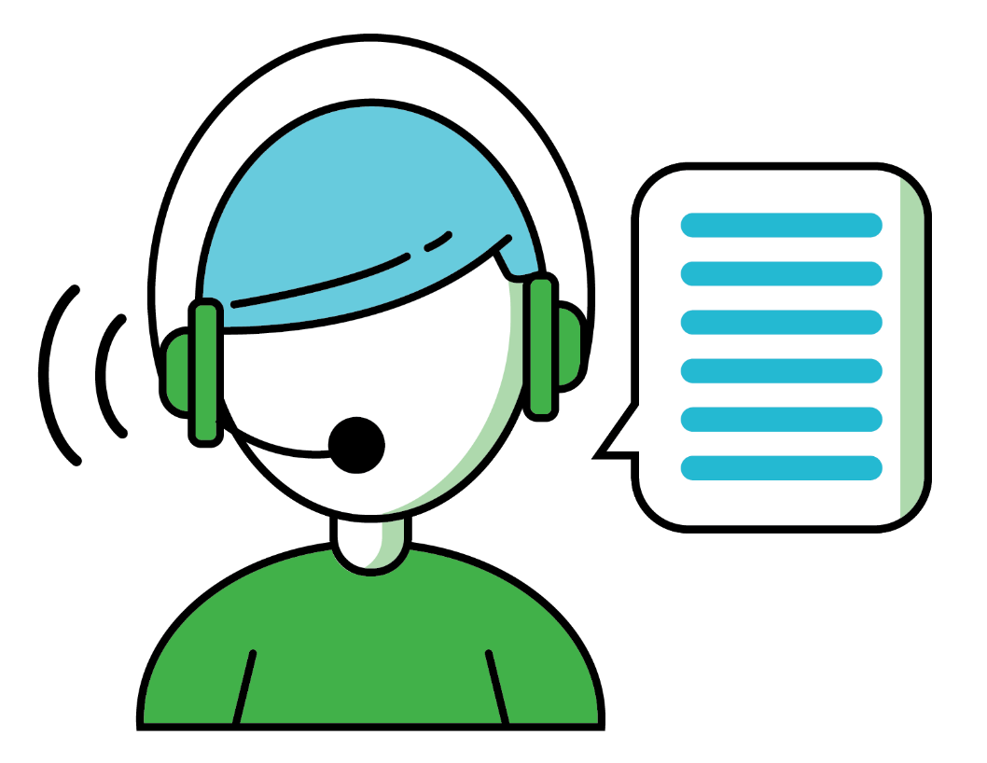
Customer service
Prefer to speak to someone?
Toll free:
1-800-448-3815
Local:
651-406-5901

