Slide 1
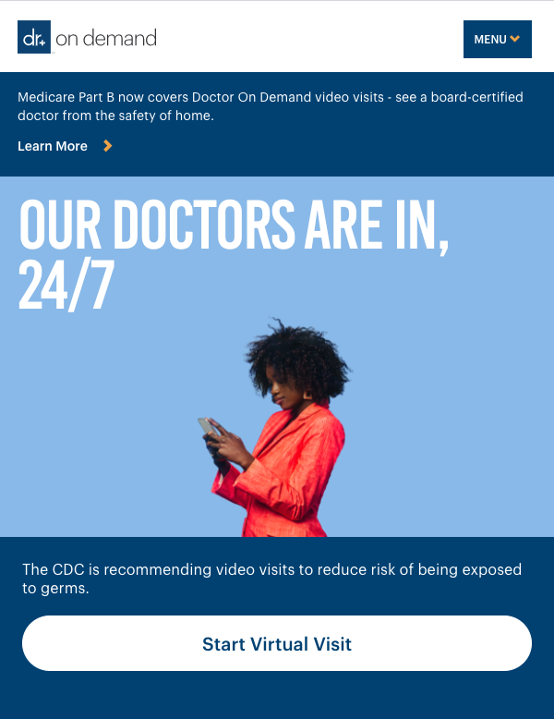



Your Doctor On Demand Benefit
Quality medical and behavioral health services any time you need them —right from home.
You can see a doctor right away from your smart phone, tablet or computer
Available to you and your covered dependents
Saves you the time and cost of traveling to the ER or Urgent Care
Treatment for urgent care, behavioral health and everyday care, including:
  Cold & flu
  Sinus infections
  Skin conditions
  Allergies
  Anxiety & depression
Download the app free from the Apple Store or Google Play, or visit doctorondemand.com/health-plans-inc from a Google Chrome browser

